Slide 1

GitHub Training
Tameka Gillett

Slide 2
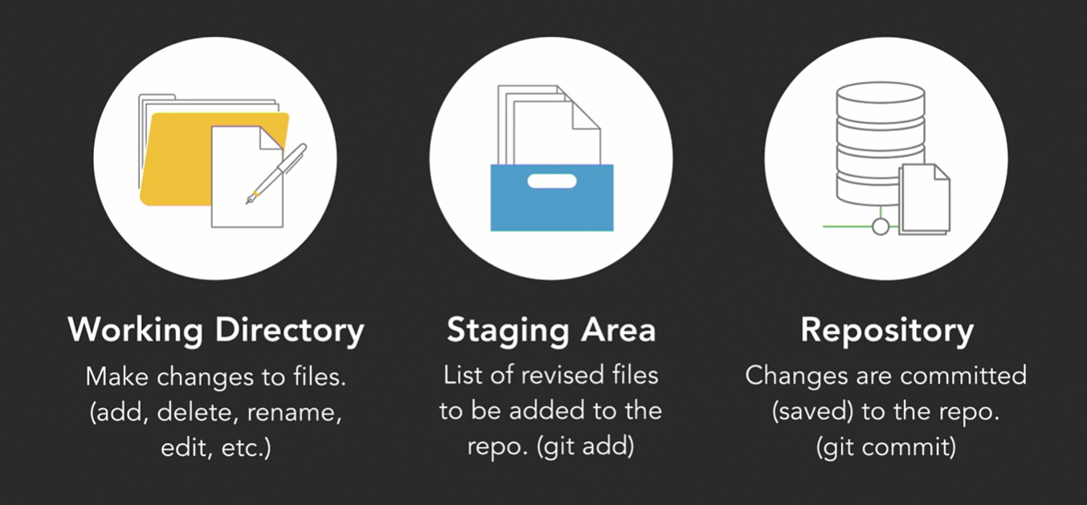
Notes:
Tree > a directory
Blob > a file (binary large object)

Slide 3
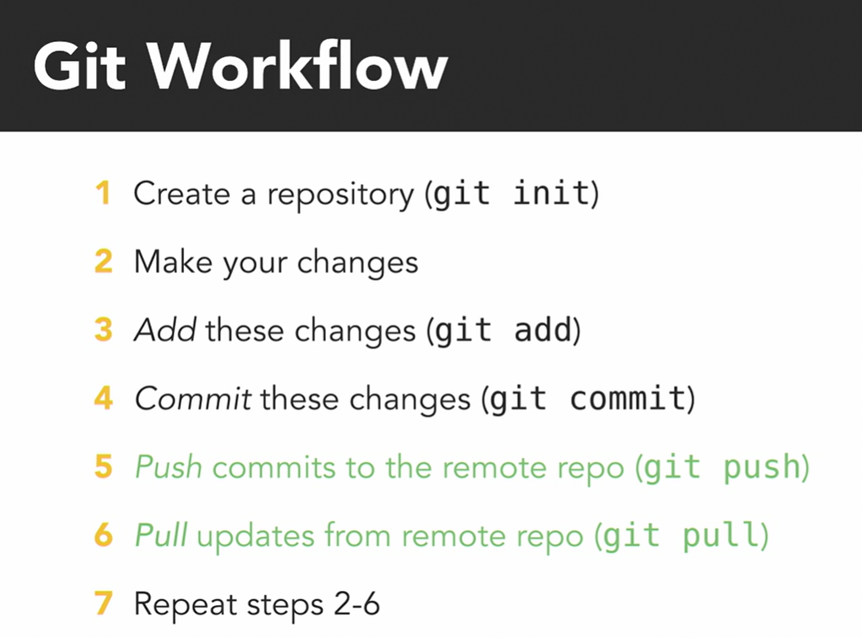
Notes:
the branch master, that's always by default the main branch, there’s nothing to commit. The working tree is clean, we now know what a tree is and we know what our working directory is, right, so the working tree is that directory of things that we're working, that Git is looking at, but are not part of the repository, and the working tree matches what's in the repository.

Slide 4
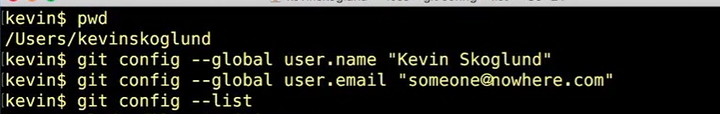
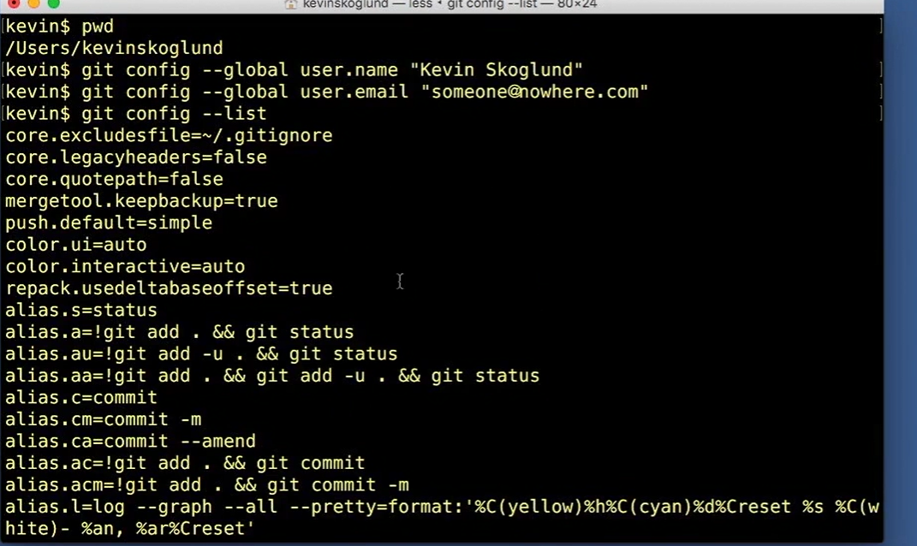
Configure your GitHub & Powershell
So what are the kinds of configurations we can set? Let's set a few. The first configuration you want to set using git config, and we're going to use --global, is going to be user.name, and this is going to be your username, and put it in quotes, mine is going to be Kevin Skoglund, of course yours will be different, this will tell it that for this user account, the username for Git should be Kevin Skoglund. And all the things I do in Git will have my name associated with it. It's also a good idea to include your email address as well, so I'm going to have user.email, and then I'll put in someone@nowhere.com, you of course would put in your real email address. Now I can type git config --list, and it will list all of my configurations. You'll see that there's a lot in there, a lot that I haven't set yet.

Slide 5
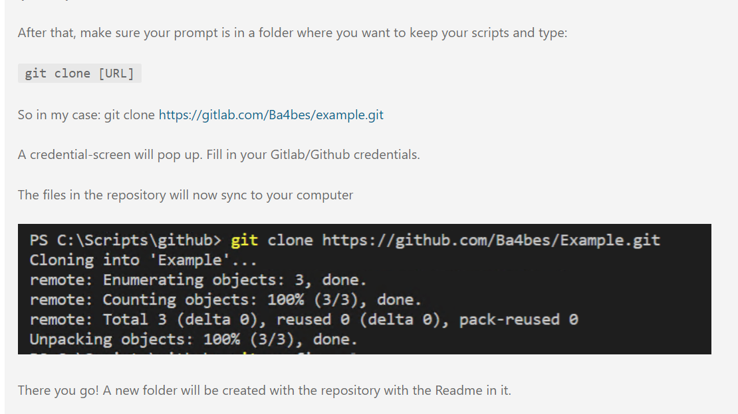

Slide 6
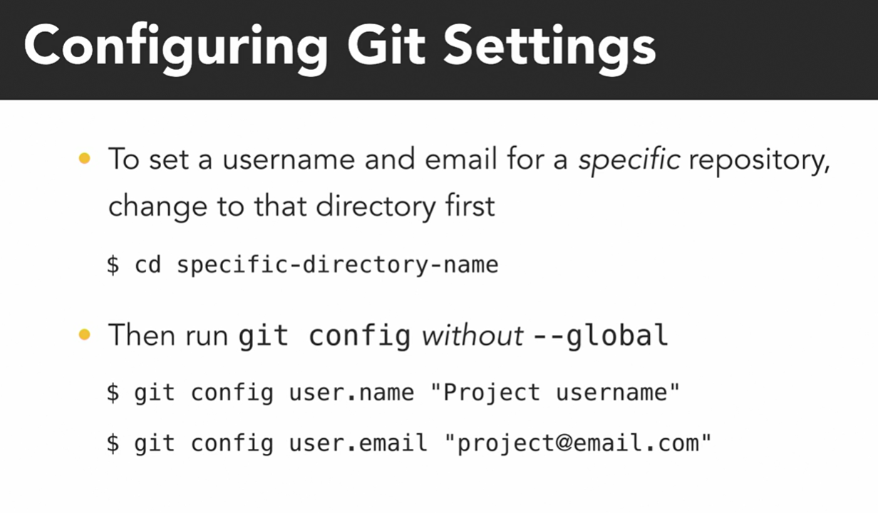
Notes:
https://lnkd.in/gXCcfdY

Slide 7
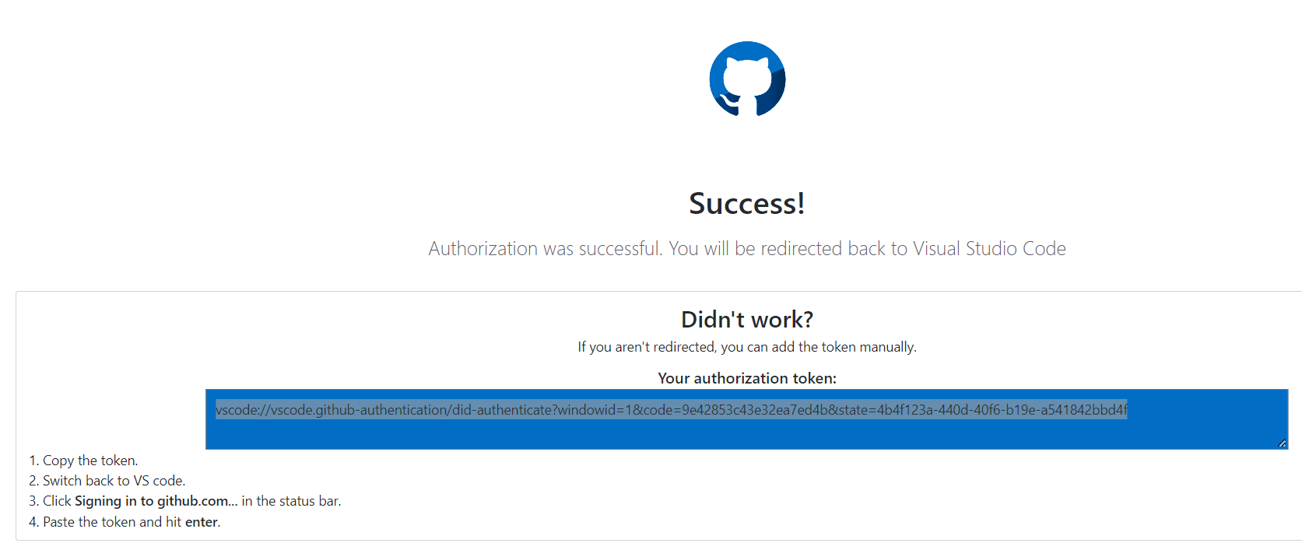
Connect Visual Studio
Notes:
https://4bes.nl/2019/06/02/step-by-step-start-using-git-for-powershell/

Slide 8
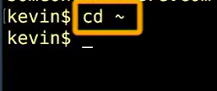
To locate where you are connected

Slide 9
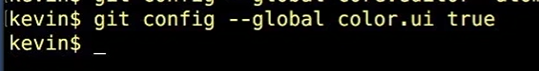
Configure it to be colored coded

Slide 10
Powershell Keyboard Movements
space or an F to go forward to the next page.
B to go backwards
Q to quit out of it

Slide 11
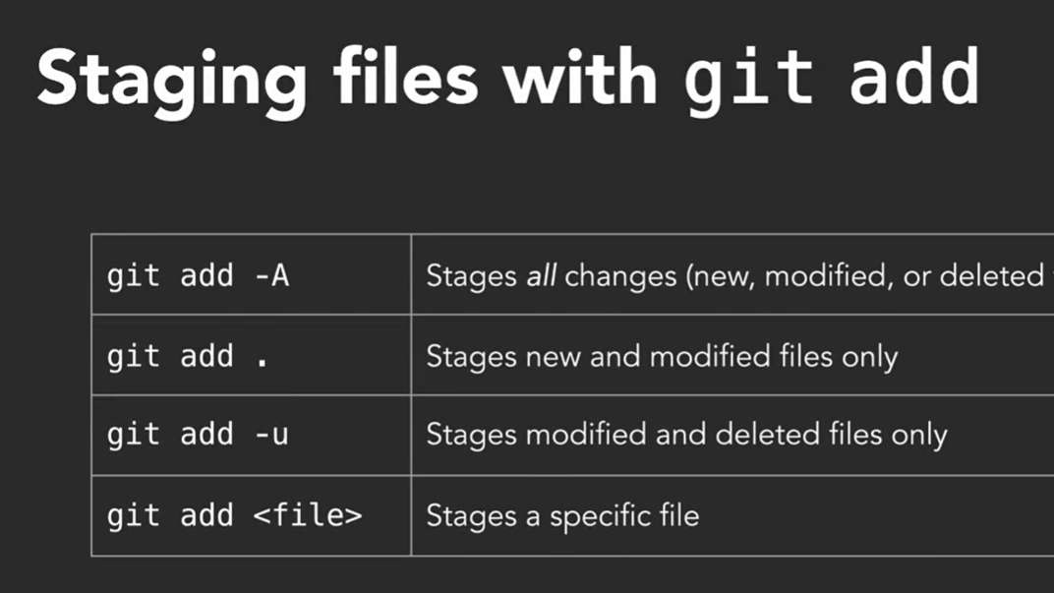

Slide 12
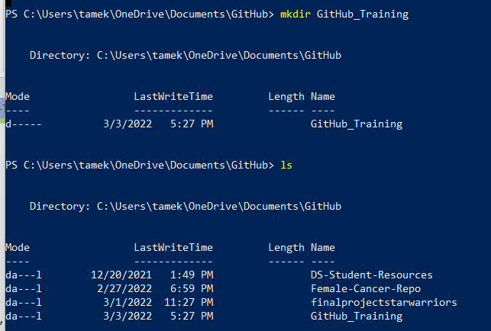
Mkdir
make a new project folder using the make directory command again, mkdir space then directory name

Slide 13
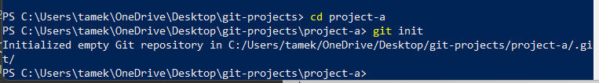
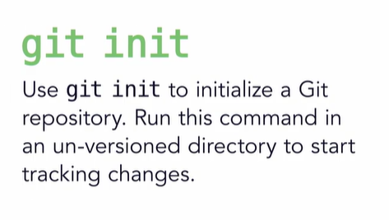
Set up a Repo
Before we can do anything with Git, we need to first create a repository. I usually designate a main folder to hold all my projects, then create individual project folders inside. Let's use the Git Projects folder we made earlier to hold all of our exercises. First, let's make sure we're in the correct directory. Use the PWD, Print Working Directory command, to check where you are.

Slide 14
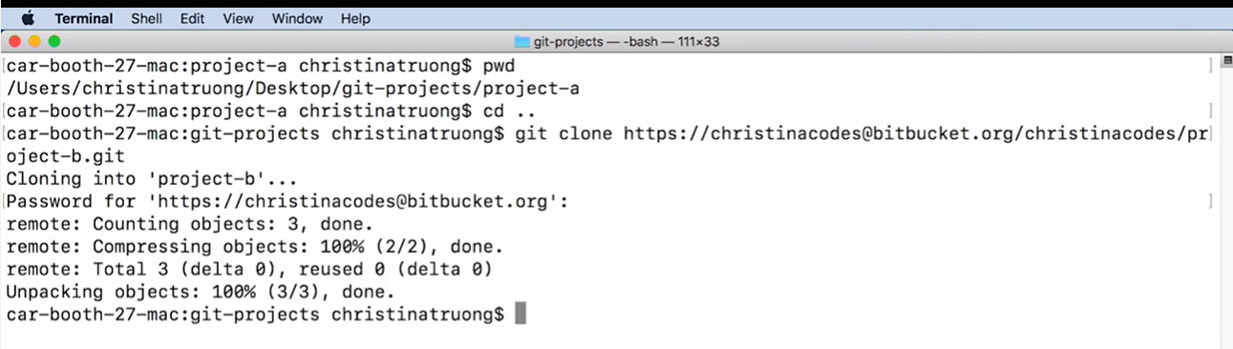
Cloning Your Repo

Slide 15
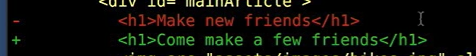
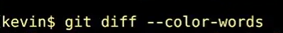
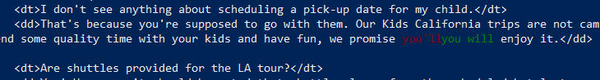
Changes to files
The plus signs indicate what was added to the file.
The minus sign is whenever we take something away from the file.
Git status
Git diff
Git log
Different ways to see what is going on by who and when
View the movement of work

Slide 16
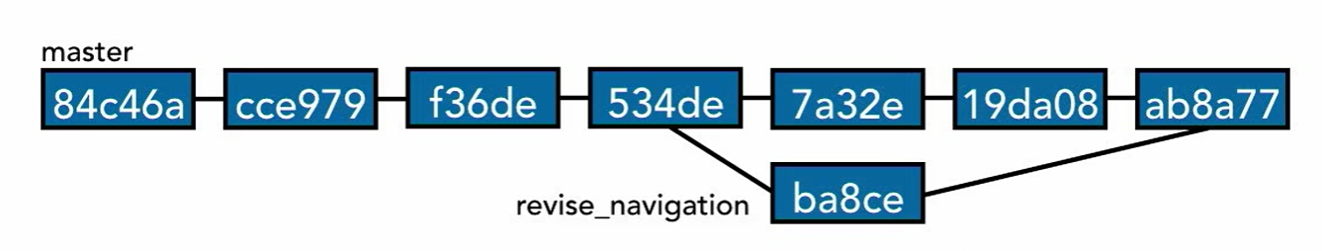
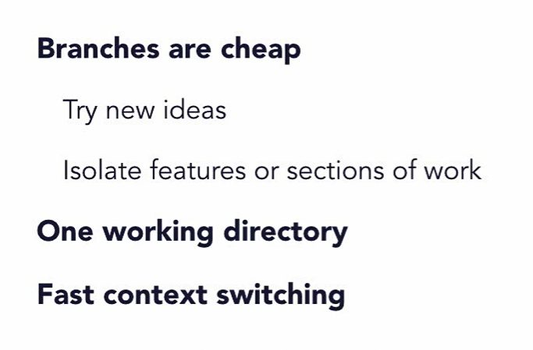
Branches

Slide 17
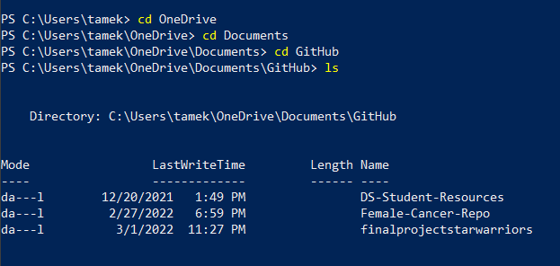
Finding your file
You can see how many repo’s you have in your GitHub

Slide 18
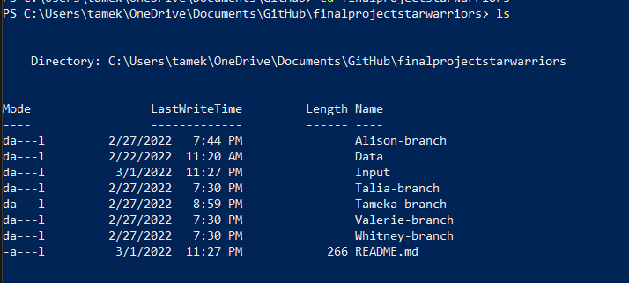
View how many files, or BLOBS, you have ls lets you view
Everyone has their own branch they can work in but you need to link it to your GitHub account to work in it

Slide 19
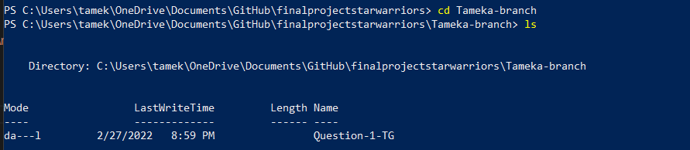
This is my branch and the ls is showing how I added my question to the master copy. Now I can just keep adding or making my changes here.

Slide 20
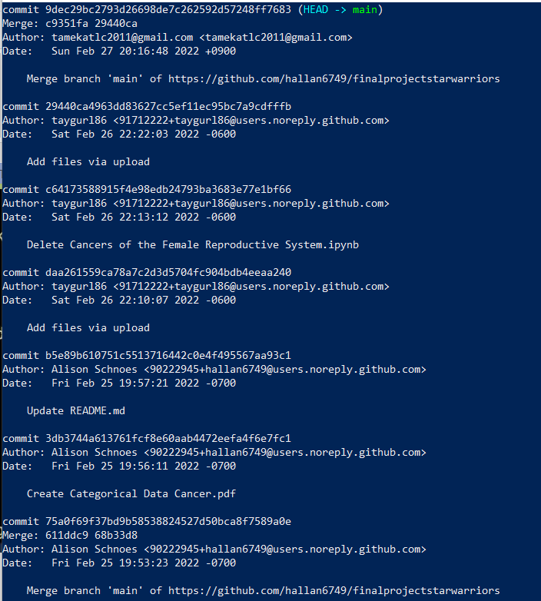
With git log, you can see who has been contributing, date, time, name
HEAD shows you where the current edit is
Each commit has it’s own number. You can pick up from that commit and make changes to that particular change without starting over.
You can do searches now by Author, Date, Commit SHA

Slide 21
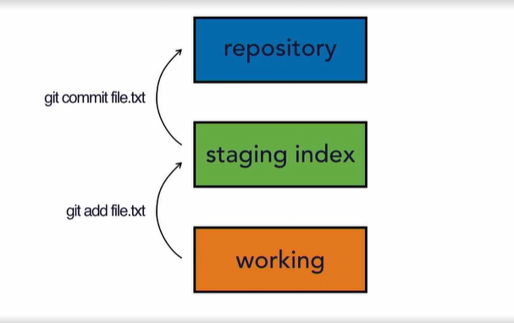
Staging
If the repository is a shared repository and many people are working from it, they may add their own changes to the repository. If I haven't checked out a copy recently, then my working copy won't have their changes. Now that's a typical two-tree architecture. Git uses a three-tree architecture. It still has the repository and the working copy, but in between is another tree, which is the staging index. When we made our first commit in the last chapter, we didn't just perform a commit. First, we used the add command. We added, then we committed. It was a two-step process. We added our files to the staging index, and then from there we committed to the repository.

Slide 22
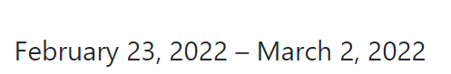
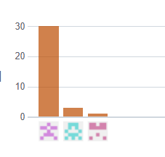
Examples of Checking/Fixing Commits
For example, Excluding merges, 3 authors have pushed 34 commits to main and 34 commits to all branches. On main, 6 files have changed and there have been 2,212 additions and 0 deletions.

Slide 23
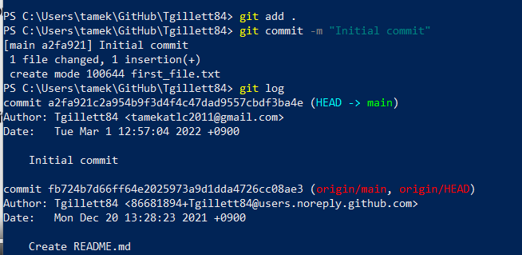
Staging Steps for checks & balances
Git add .
Git commit –m “write your comment for the team”
Git log (to check the work)
*you can skip the staging area, but if you aren’t 100% sure that you want to commit, you caused yourself more work

Slide 24
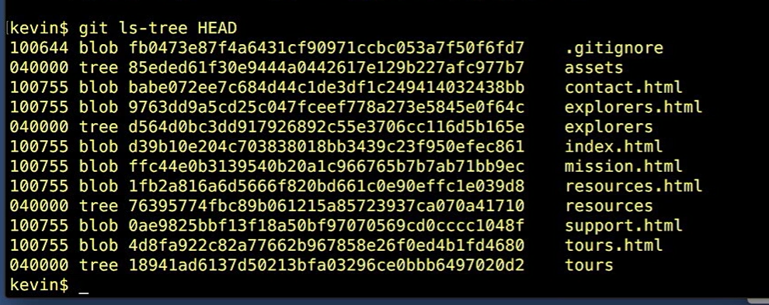
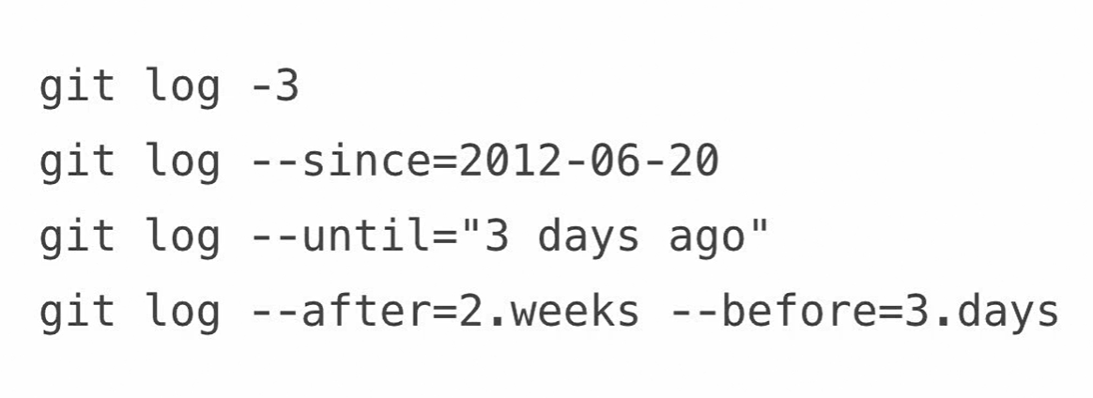
Show your trees a tree in Git is just a directory

Slide 25
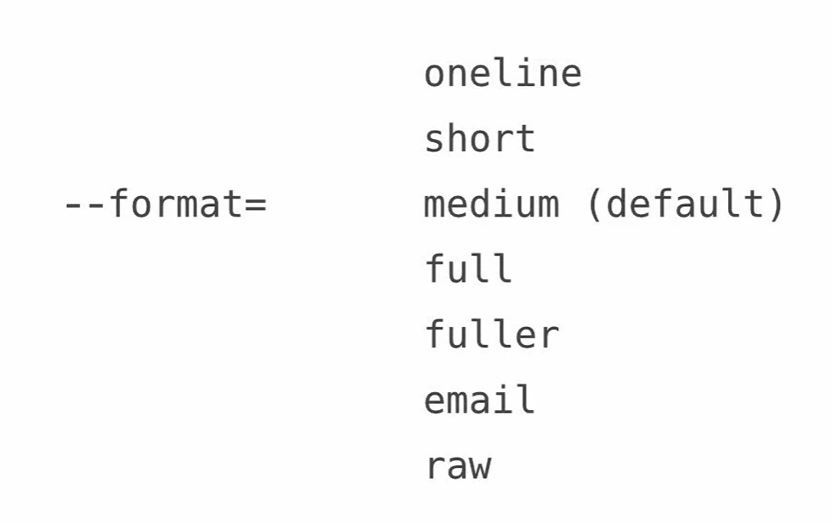
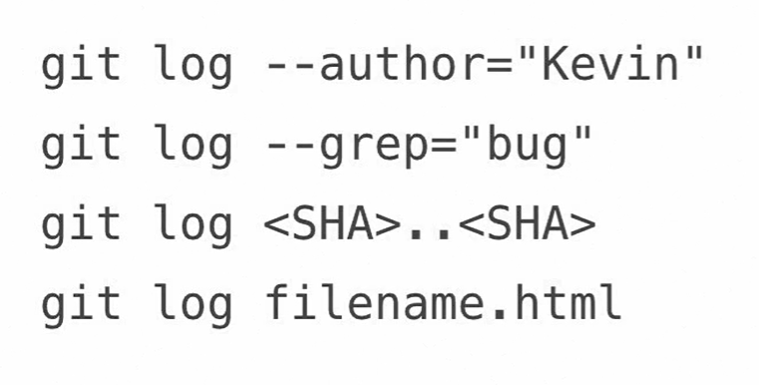
Other git log code

